Slide 1

Unity 3D Essentials
Advanced Scripting Optimizations
SoftUni Team
Technical trainers
Software University
https://softuni.org

Slide 2

Table of Contents
Advanced Methods in Unity
Performance Techniques
Code Practices
Useful links

Slide 3
Have a Question?
sli.do
#Unity3D-Basics
Notes:
‹#›

Slide 4

Advanced Methods

Slide 5
Coroutines
IEnumerator Move()
{
for (int i = 0; i < 10; i++)
{
transform.Translate(-0.05f, 0f, 0f);
yield return new WaitForSeconds(0.5f);
}
}

Slide 6
Unity web request
IEnumerator DownloadStuff()
{
using (var webRequest = UnityWebRequestTexture.GetTexture(url))
{
Debug.Log("Start downloading at : " + Time.frameCount);
yield return webRequest.SendWebRequest();
Debug.Log("Finish downloading at : " + +Time.frameCount);
if (webRequest.isNetworkError || webRequest.isHttpError)
{
Debug.Log(webRequest.error);
}
else
{
// Get downloaded asset bundle
RawImageUI.texture = DownloadHandlerTexture.GetContent(webRequest);
}
}
}

Slide 7
Add menus to Editor
[MenuItem ("GameObject/Get Names of Selection")]
static void MenuAddChild()
{
GameObject[] selectedObjects = Selection.gameObjects;
foreach (GameObject go in selectedObjects)
{
Debug.Log("Object name is : " + go.name);
}
}

Slide 8
Player Prefs
void SaveProgress()
{
PlayerPrefs.SetInt("Score", 454);
}
void LoadProgress()
{
Debug.Log("Get score : " + PlayerPrefs.GetInt("Score", 0));
}

Slide 9

Performance Optimizations

Slide 10
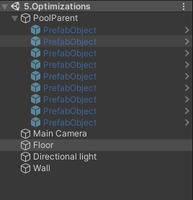
Object pooling
Why?
Pre-Made
Filled in at the Awake/Start
Dynamically add
Instantiate when empty

Slide 11
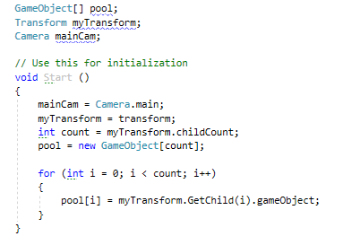
Cache components lookups
Why?
When?
GetComponent<>
Awake/Start

Slide 12
General Rules
Callings in the Update
OnBecameVisible
Lambda & Linq
Use same material across GOs
Keep layer collision matrix updated to your needs

Slide 13
General Rules
Bulk operations spread in frames
Coroutines
Always destroy GO when not needed
Collections that have static size -> arrays
Garbage Collector

Slide 14

LAB

Slide 15
Lab practice
Open scene Lab
Alter the PoolManager.cs script to:
Upon mouse click to fire the ball at the direction of the click
Start position of the ball should be 0.5m below the camera
If the ball hits the Target GO to disable itself
If the pool runs out of prefabs to create/instantiate another one

Slide 16
Useful Links
https://docs.unity3d.com/Manual/LogFiles.html
https://docs.unity3d.com/Manual/PlatformDependentCompilation.html
https://docs.unity3d.com/ScriptReference/MenuItem.html

Slide 17

Summary
Advanced Methods in Unity
Performance Techniques
Code Practices
Useful links
Notes:
‹#›

Slide 18
Questions?
Email : dstrashilov@gmail.com
Notes:
‹#›

Slide 19

License
This course (slides, examples, demos, exercises, homework, documents, videos and other assets) is copyrighted content
Unauthorized copy, reproduction or use is illegal
© SoftUni – https://about.softuni.bg
© Software University – https://softuni.bg
Notes:
‹#›

Slide 20
Trainings @ Software University (SoftUni)
Software University – High-Quality Education, Profession and Job for Software Developers
about.softuni.bg, softuni.org
Software University Foundation
softuni.foundation
Software University @ Facebook
facebook.com/SoftwareUniversity
Software University Forums
forum.softuni.bg
Notes:
‹#›

